Slide 1

Python Advanced
Course Introduction
SoftUni Team
Technical Trainers
Software University
https://softuni.bg/

Slide 2
Table of Contents
Course Objectives
Training and Team
Course Organization
Course Infrastructure
Evaluation Criteria
2

Slide 3
Have a Question?
sli.do
#python-advanced

Slide 4

Course Objectives

Slide 5
Python Advanced Objectives
Working with Lists as Stacks and Queues
Working with Tuples and Sets
Creating and working with Multidimensional Lists
Learn functional programming
Working with Files
Handling Exceptions
5

Slide 6
Practical Programming Exam
Exam – 4 hours
3 practical problems
Stacks and Queues
Multidimensional Lists
Functions
6

Slide 7
Theoretical Exam
You will have 30 minutes once you enter
Multiple-choice with 1 correct answer
Test will be in English
Automated quiz system
Available on the day of the practical exam
You can submit your answers just one time
7

Slide 8

The Team

Slide 9
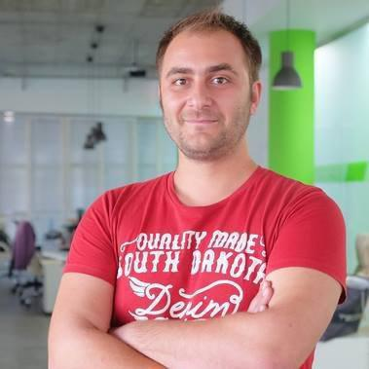
Doncho Minkov
Senior Full Stack Developer in SoftUni
10+ years in IT
8+ years of experience as a
Technical Trainer @ Telerik Academy
Front-end developer by heart
Software developer by need
Experience with all popular mobile platforms
Android, iOS, Windows
Fluent in Node.js, .NET, Angular, Java, C++
"30 under 30" – Forbes 2017 - Education

Slide 10
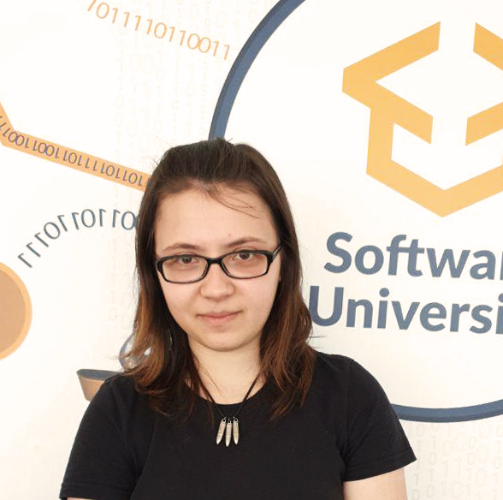
Tanya Staneva
Technical Trainer and Program Lead at SoftUni
SoftUni Top Student
Passionate about Python technologies
Interested in Machine Learning and AI

Slide 11

Course Organization

Slide 12
Python Advanced Course
16-Jan-2020
23-Feb-2020
8-Apr-2020
Python Advanced
6 weeks * 4 times / week
12 credits
Start: 16-Jan-2020
Theoretical Exam: 23-Feb-2020
Final exam: 23-Feb-2020
Re-Take Exams
Тheoretical Exam: 8-Apr-2020
Final Exam Retake : 8-Apr-2020

Slide 13

Homework Assignments & Exercises
Your homework is mainly work in class
Lesson days → slides + live demos + exercises
Exercise days → only exercises
How to submit your homework?
Submitted in the judge system
Do your homework when it's due
Assignments pile up quickly

Slide 14



Scoring System for the Course
Theoretical Exam 5%
Practical Exam 90%
Presence in class 5%
Evaluation
Homework 5 %
14

Slide 15


Course Web Site, Forum and FB Group
Official web site:
Official Facebook group:
Softuni Python Community group:
https://softuni.bg/courses/python-advanced
facebook.com/groups/PythonAdvancedJanuary2020/
https://www.facebook.com/groups/SoftUniPythonCommunity

Slide 16
Questions?
Notes:
16

Slide 17












SoftUni Diamond Partners

Slide 18




SoftUni Organizational Partners

Slide 19
Trainings @ Software University (SoftUni)
Software University – High-Quality Education, Profession and Job for Software Developers
softuni.bg, softuni.org
Software University Foundation
softuni.foundation
Software University @ Facebook
facebook.com/SoftwareUniversity
Software University Forums
forum.softuni.bg
19
Notes:
19

Slide 20

License
This course (slides, examples, demos, exercises, homework, documents, videos and other assets) is copyrighted content
Unauthorized copy, reproduction or use is illegal
© SoftUni – https://softuni.org
© Software University – https://softuni.bg
Notes:
20

